Slide 1
Physics in Computer Graphics
Ju Yun Kim and Dmitry Tensyn

Slide 2
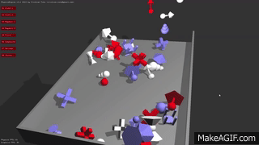

Slide 3
Data Types
Dynamic Bodies – abstracted physical objects
Geom Bodies – geometric meshs for collision detection
  Trimesh class – useful for the kind of meshes that we have

Slide 4
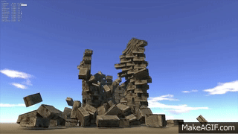

Slide 5
For the time being…
Notes:
Show our demo

